Slide 1
CREDIT SCORE CLASSIFICATION
PROJECT BY : Subodh Kumar

Slide 2

INTRODUCTION
Credit score classification is an important task in financial sector.
It helps banks and financial institutions assess a customer’s creditworthiness.
A credit score indicates how likely a customer is to repay loans on time.
In this project, machine learning techniques are used to classify credit scores.
The model analyzes customer financial and personal data to make predictions.
This system helps reduce financial risk and supports better lending decisions.

Slide 3

Problem understanding
Data Collection
Data Preprocessing
Feature Engineering
Train-Test split
Model Used
Model Selection
Conclusion & Insights
Exploratory Data Analysis (EDA)
WORKFLOW
WORKFLOW
WORKFLOW

Slide 4

PROBLEM STATEMENT
Financial institutions need an accurate way to assess customer creditworthiness.
Manual and rule-based credit evaluation methods are time-consuming and error-prone.
Incorrect credit assessment can lead to higher default risk and financial losses.
There is a need for an automated system to classify customers into credit score categories.
This project aims to use machine learning models to predict credit scores based on customer financial and demographic data.

Slide 5

DATA CLEANING
Loaded the dataset and examined its overall structure and quality.
Removed duplicate records to avoid biased learning.
Corrected inconsistent values present in numerical and categorical columns.
Handled incorrect or invalid entries such as unrealistic ages, incomes, and credit values.
Standardized categorical values to maintain consistency across the dataset.
Ensured all features were in the correct data format for further preprocessing.
Verified the dataset after cleaning to ensure it was error-free and reliable.

Slide 6

DATA PREPROCESSING
Checked for missing values in both numerical and categorical features.
Imputed missing numerical values using suitable statistical methods.
Handled missing categorical values using appropriate techniques.
Encoded categorical variables into numerical format for machine learning models.
Scaled numerical features to bring them to a uniform range.
Prepared the final processed dataset for model training and evaluation.

Slide 7

EXPLORATORY DATA ANALYSIS(EDA)
The dataset consists of customer demographic and financial features related to credit behavior.
Both numerical and categorical variables are present in the data.
Initial analysis revealed missing values in multiple columns, which required cleaning and preprocessing.
The Credit Score target variable is divided into different categories.
The target classes are imbalanced, meaning some credit score categories have more samples than others.
Numerical features such as Annual Income, Monthly Inhand Salary, Outstanding Debt, and Credit Utilization Ratio show wide variation across customers.
Customers with higher income and lower debt tend to belong to better credit score categories.
Credit history age shows a positive relationship with higher credit scores.
EDA helped identify important features that contribute significantly to credit score prediction.

Slide 8
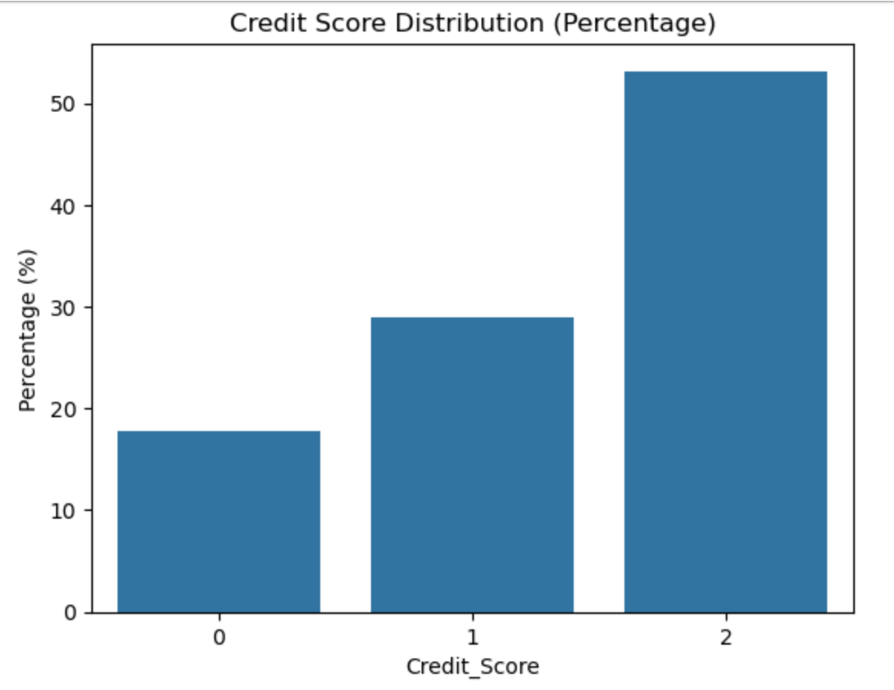
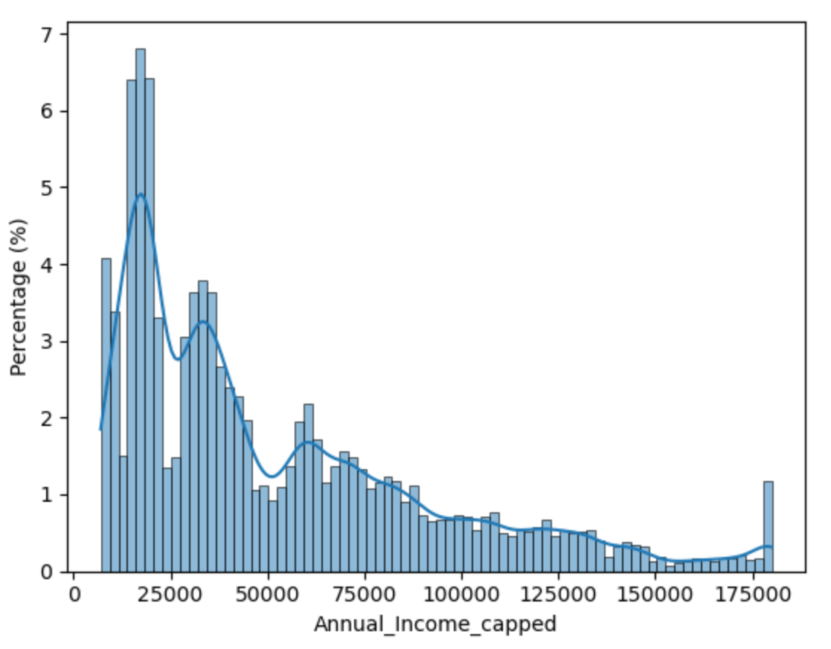
EXPLORATORY DATA ANALYSIS (EDA)
Mapping
0 → Poor
1 → Standard
2 → Good
The graph represents the distribution of Annual Income after applying capping to handle extreme values.
Most customers have lower to mid-range annual incomes, concentrated on the left side of the graph.
The distribution is right-skewed, meaning a small number of customers earn very high incomes.
The KDE curve shows a smooth decline as income increases, confirming fewer high-income customers.
Capping helps improve model stability by preventing extreme income values from dominating learning.
The graph represents the percentage share of each credit score category.
Credit_Score = 2 has the highest percentage (around 53%), meaning most customers fall into this category.
Credit_Score = 1 accounts for approximately 29% of the customers.
Credit_Score = 0 has the lowest percentage (around 18%).
Since one class dominates the data, special care is needed during model evaluation and selection.

Slide 9
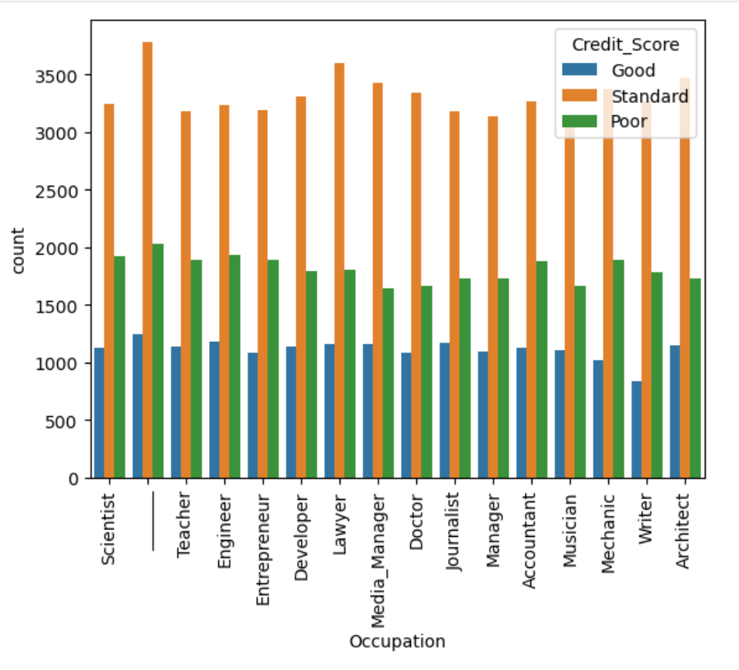
EXPLORATORY DATA ANALYSIS (EDA)
The graph compares Good, Standard, and Poor credit scores for different occupations.
Across all occupations, the Standard credit score category has the highest count.
The Poor credit score category is the second most common across occupations.
This indicates that credit score distribution is fairly consistent across professions.
No single occupation dominates the Good credit score category significantly.
Credit score classification depends more on financial behavior than occupation alone.

Slide 10
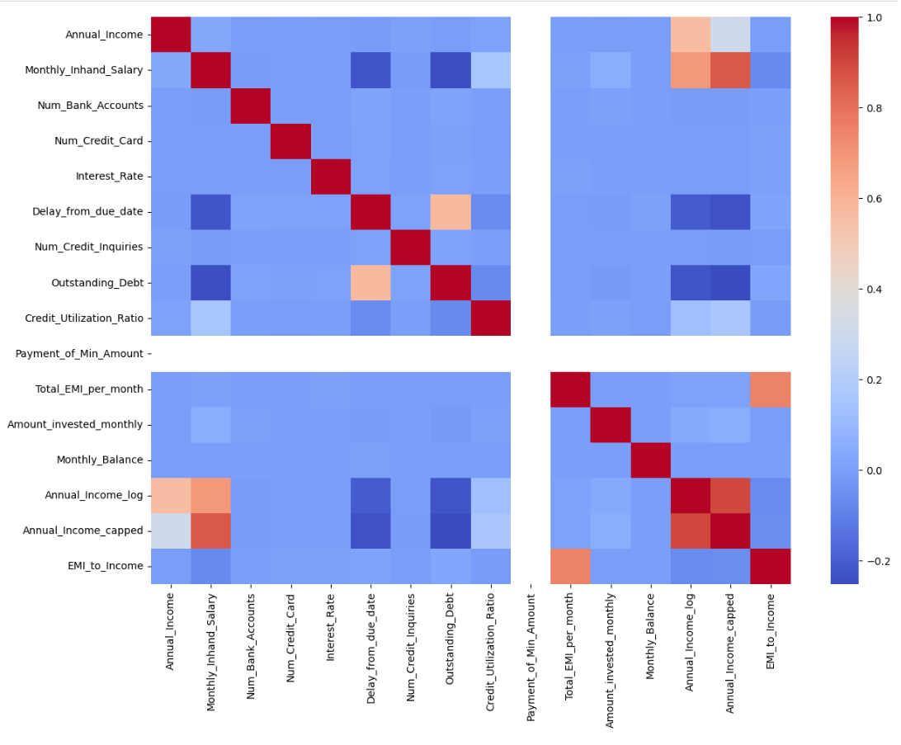
EXPLORATORY DATA ANALYSIS (EDA)
Correlation Heatmap Analysis
The heatmap shows the strength and direction of correlation between numerical variables.
Red / warm colors indicate strong positive correlation, while blue / cool colors indicate negative correlation.
Annual Income, Monthly Inhand Salary, Annual_Income_log, and Annual_Income_capped show strong positive correlations, meaning they represent similar income-related information.
Outstanding Debt shows a positive correlation with Delay from Due Date, indicating higher debt is associated with delayed payments.
Credit Utilization Ratio has a negative correlation with income-related features, suggesting lower-income individuals tend to use a higher proportion of their credit.
EMI_to_Income shows a positive relationship with Total EMI per month, indicating higher EMIs relative to income increase financial burden.
Most other features show low correlation, which reduces multicollinearity and is beneficial for machine learning models.

Slide 11

FEATURE ENGINEERING……
Objective:
The objective of feature engineering is to create informative financial risk indicators that improve the accuracy of credit score prediction models.
Created Total Credit Exposure using Outstanding Debt and Total EMI per month.
Derived Delay Severity from payment delay and number of delayed payments.
Calculated EMI to Income Ratio to measure repayment burden.
Developed Savings Index using Monthly Balance and Outstanding Debt.
Introduced High Risk Flag for customers with:
Delay > 30 days
Credit Utilization > 70%
Engineered Utilization × Debt feature to capture combined financial risk.
Removed irrelevant and sensitive columns (Name, SSN, ID).
Final dataset size after feature engineering: 100,000 records × 35 features.

Slide 12

MODELS USED
DECISION TREE
Used as a simple and interpretable baseline model.
Captures non-linear relationships in the data.
Helps understand decision rules affecting credit score.
Provides a reference point for comparing advanced models.
RANDOM FOREST
An ensemble of multiple decision trees.
Reduces overfitting seen in single decision trees.
Handles large and complex datasets effectively.
XGBOOST
A powerful gradient boosting algorithm.
Efficient in handling complex patterns and feature interactions.
Performs well on structured financial datasets.
Provides strong accuracy with optimized learning.
LIGHTGBM
A fast and efficient boosting-based model.
Handles large datasets with high dimensionality.
Reduces training time while maintaining good performance.
Suitable for real-world financial applications.
CATBOOST
Designed to handle categorical features effectively.
Reduces the need for extensive encoding.
Provides stable performance with minimal preprocessing.
Helps prevent overfitting in complex datasets.

Slide 13

MODEL SELECTION
Model | Accuracy | Macro Avg F1-Score | Weighted Avg F1-Score | Perfomance
Decision Tree | 0.70 | 0.68 | 0.71 | Basic Baseline
Random Forest | 0.80 | 0.79 | 0.80 | Best Model
XGBoost | 0.76 | 0.75 | 0.76 | Strong
LightGBM | 0.76 | 0.75 | 0.76 | Efficient
CatBoost | 0.72 | 0.71 | 0.73 | Moderate
⭐ Best Model Selected
Random Forest
Highest accuracy (80%)
Best balance of precision, recall, and F1-score.
Strong generalization on unseen data.
Key Insights
Random Forest achieved the highest accuracy (80%) among all models.
XGBoost and LightGBM showed similar and competitive performance.
Decision Tree performed the weakest due to overfitting.
CatBoost performed moderately but did not outperform Random Forest.

Slide 14
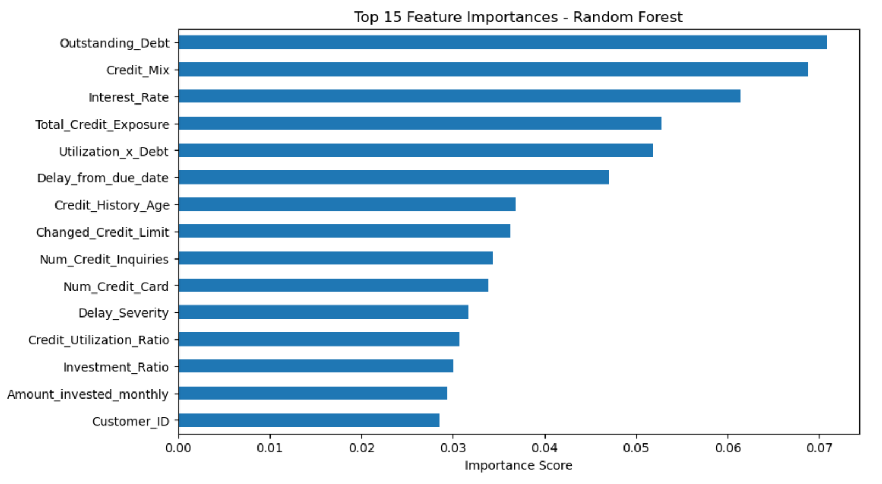
FEATURE IMPORTANCE
The chart shows the most important features used by the Random Forest model.
Outstanding Debt is the strongest factor influencing credit score prediction.
Credit Mix and Interest Rate also play major roles.
Features related to repayment behavior (delays, utilization) significantly affect credit score.
Credit history age positively contributes to better credit scores.
The model relies mainly on financial behavior and debt management features.
These key features significantly drive the Random Forest model’s accuracy and decision-making.

Slide 15

CONCLUSION….
A machine learning–based approach was successfully developed for credit score classification.
Data cleaning, preprocessing, and feature engineering improved data quality and model performance.
Multiple models were evaluated to identify the best-performing algorithm.
Random Forest emerged as the most effective model with the highest accuracy and balanced performance.
Feature importance analysis showed that debt level, credit mix, repayment behavior, and credit history are key drivers of credit scores.
The final model can help financial institutions make accurate and data-driven credit decisions.

Slide 16
THANK YOU

